Slide 1
Annealing Analysis of Pin Diodes
Andrew Kent
Brown University
Department of Physics

Slide 2
Outline
Pin Temperature Study
Setup
Saturation Time/Voltage
Saturation Voltage vs. Temperature
Pin Annealing Study
Setup
Annealing Graphs with all diodes
Data: Raw and Normalized
Shifting in Annealing Time (t) and Scaling in Potential (V)
Double Exponential Fit
100C Fitting for Other Annealing Temperatures
Fitting “Scaling Coefficients”
Conclusion / Remaining Questions

Slide 3
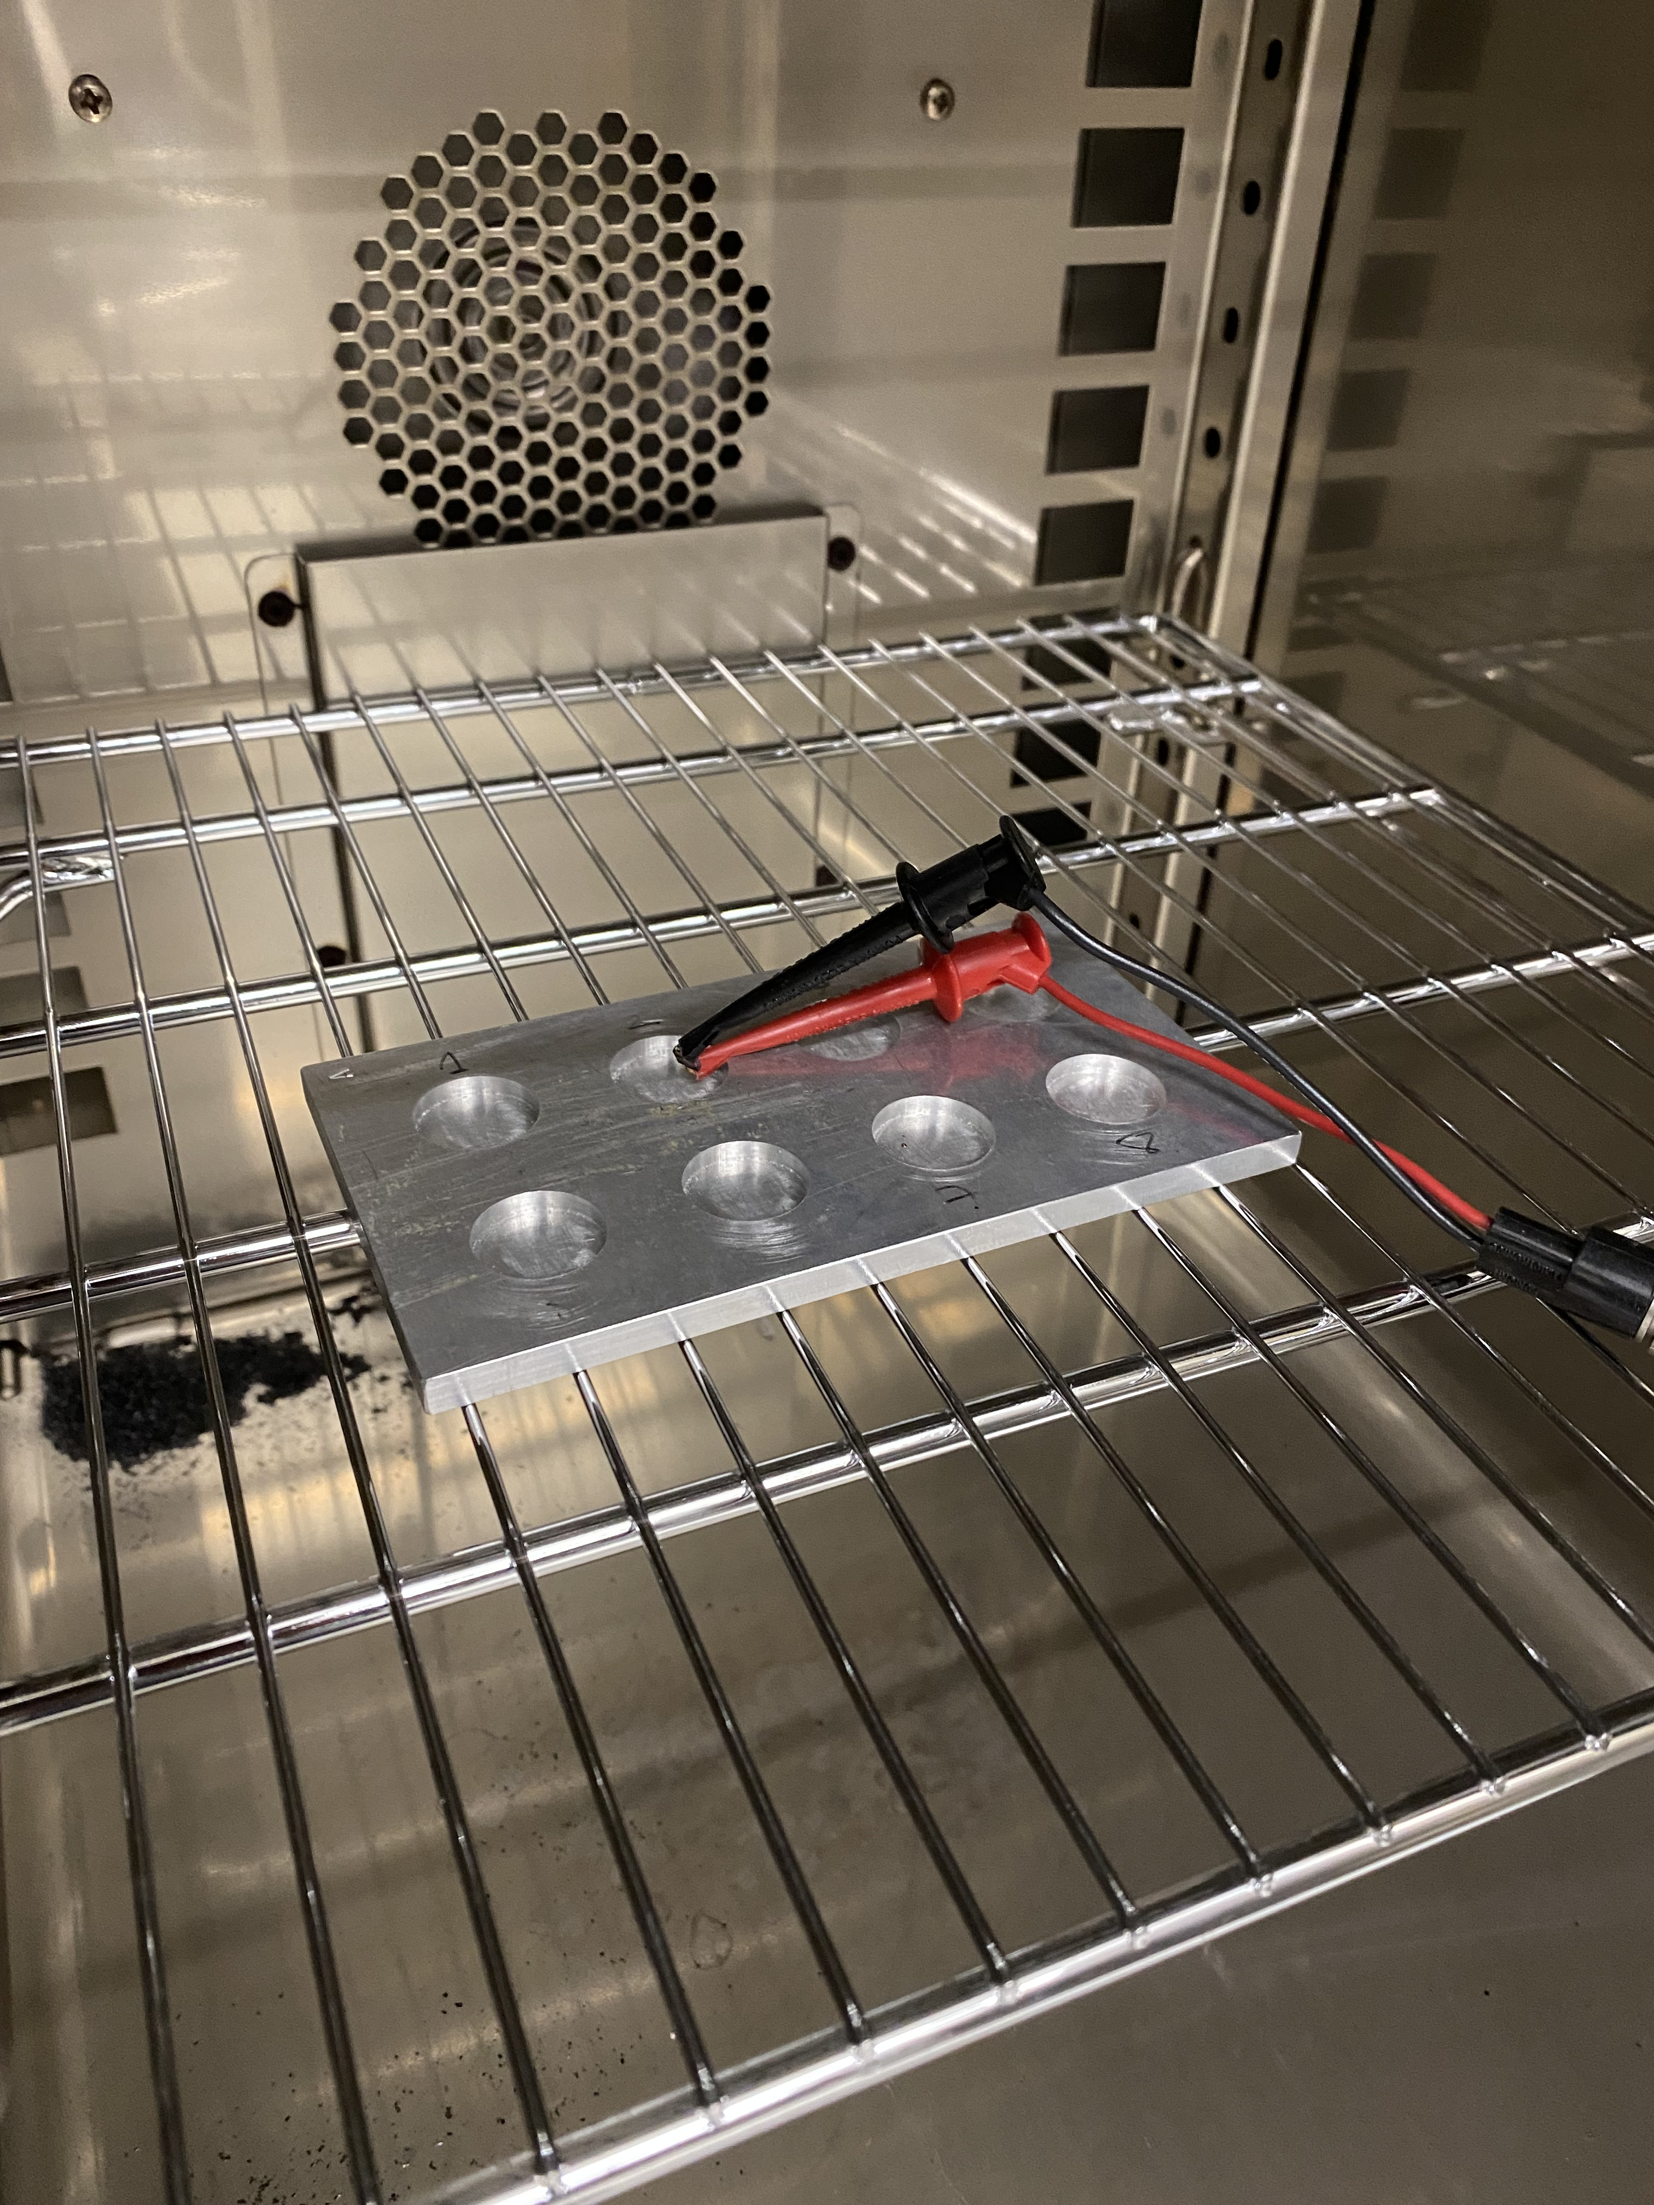
Pin Temperature Study: Setup
Objective was to find how much of an influence temperature had on the forward voltage, and if there was a simple relationship between temperatures (i.e. a “pin thermometer”)
Measured an unirradiated pin diode every second with a ~10ms pulse of 1E-5 A’s
Started at room temp (23.13C), then put pin attached with alligator clips into HERATherm oven set to 40C, 60C, 80C, 100C and 120C
Also went from room temp to freezer (-23C)

Slide 4
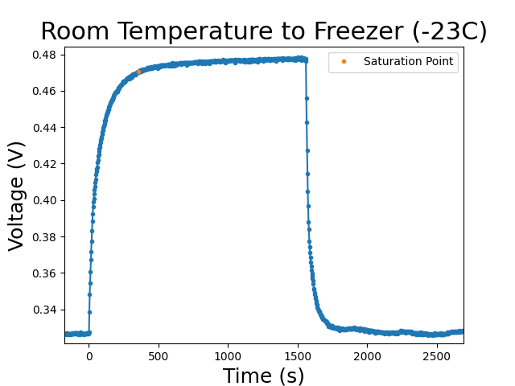
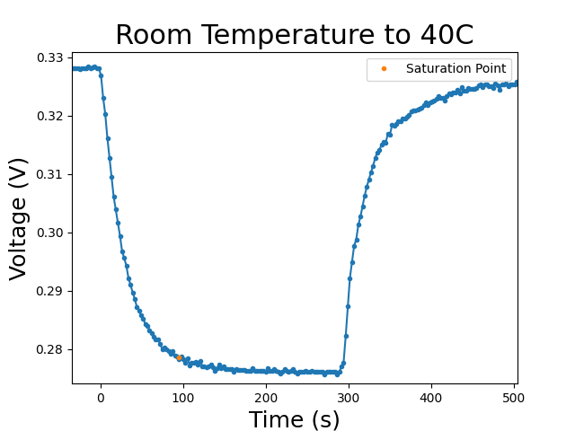
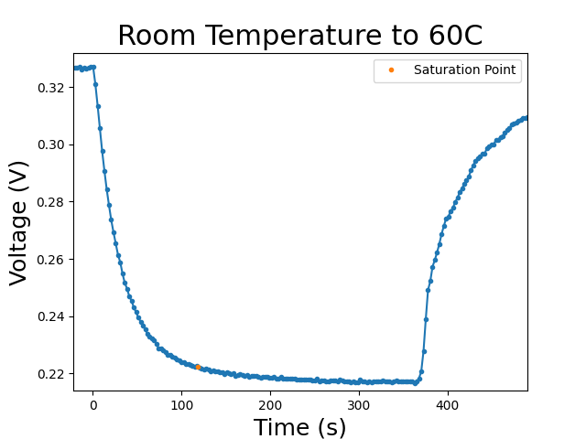
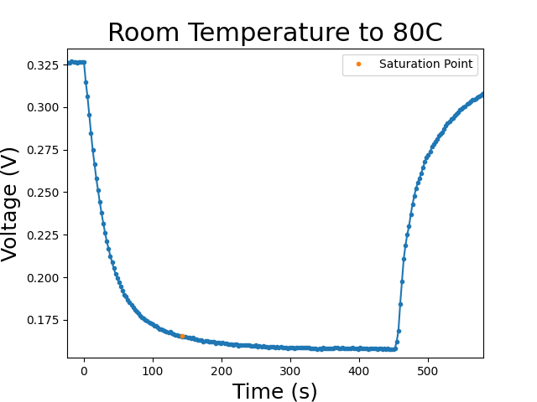
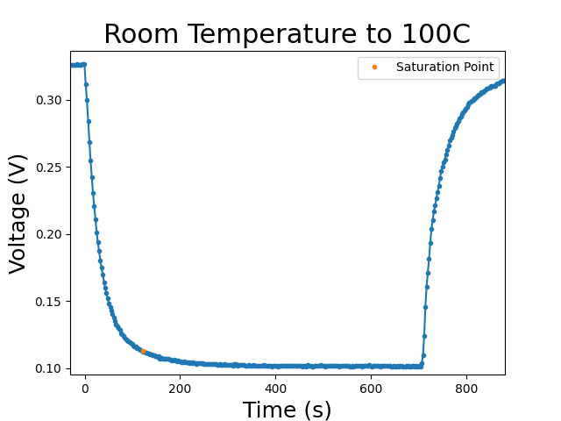
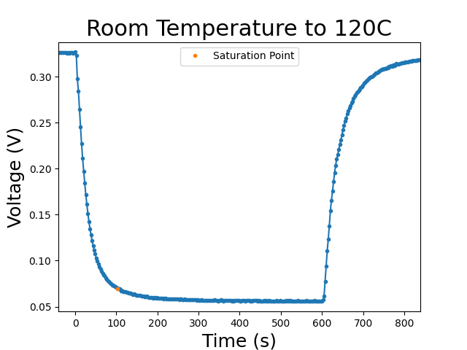
Data & Saturation Time/Voltage
Calculated the time it took for the pin diode to reach 95% of its saturation voltage
RT to Freezer took ~5 minutes, significantly shorter for the reverse
RT to 100C took 122 seconds to reach saturation, or 42 seconds of equivalent 100C annealing
100C to RT took 6 seconds of equivalent 100C annealing to cool
Total annealing achieved per run in the oven at a specific temperature was calculated using the equation below, where for instance the ramp up equivalent is the integrated ramp up annealing
Similar calculations were made for each temperature when considering the actual time spent annealing at a specific temperature

Slide 5
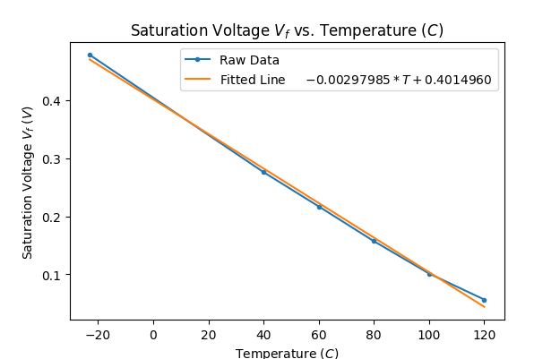
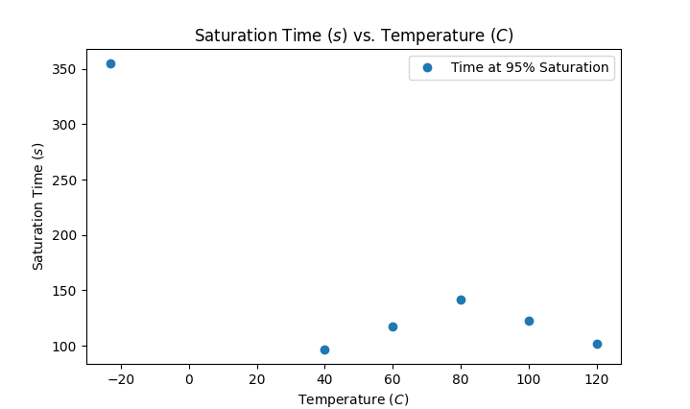
Saturation time and voltage vs. temperature
Saturation voltage remains “very” linear with temperature up to ~120C, indicates a clear and simple relationship between saturation voltage and temperature
Saturation time increases with temperature, but then falls after 80C
Indicates that errors associated with the pin heating up to annealing temperatures will matter for shorter measurements (< ~ 10 minutes) and will be almost insignificant for overnight measurements

Slide 6
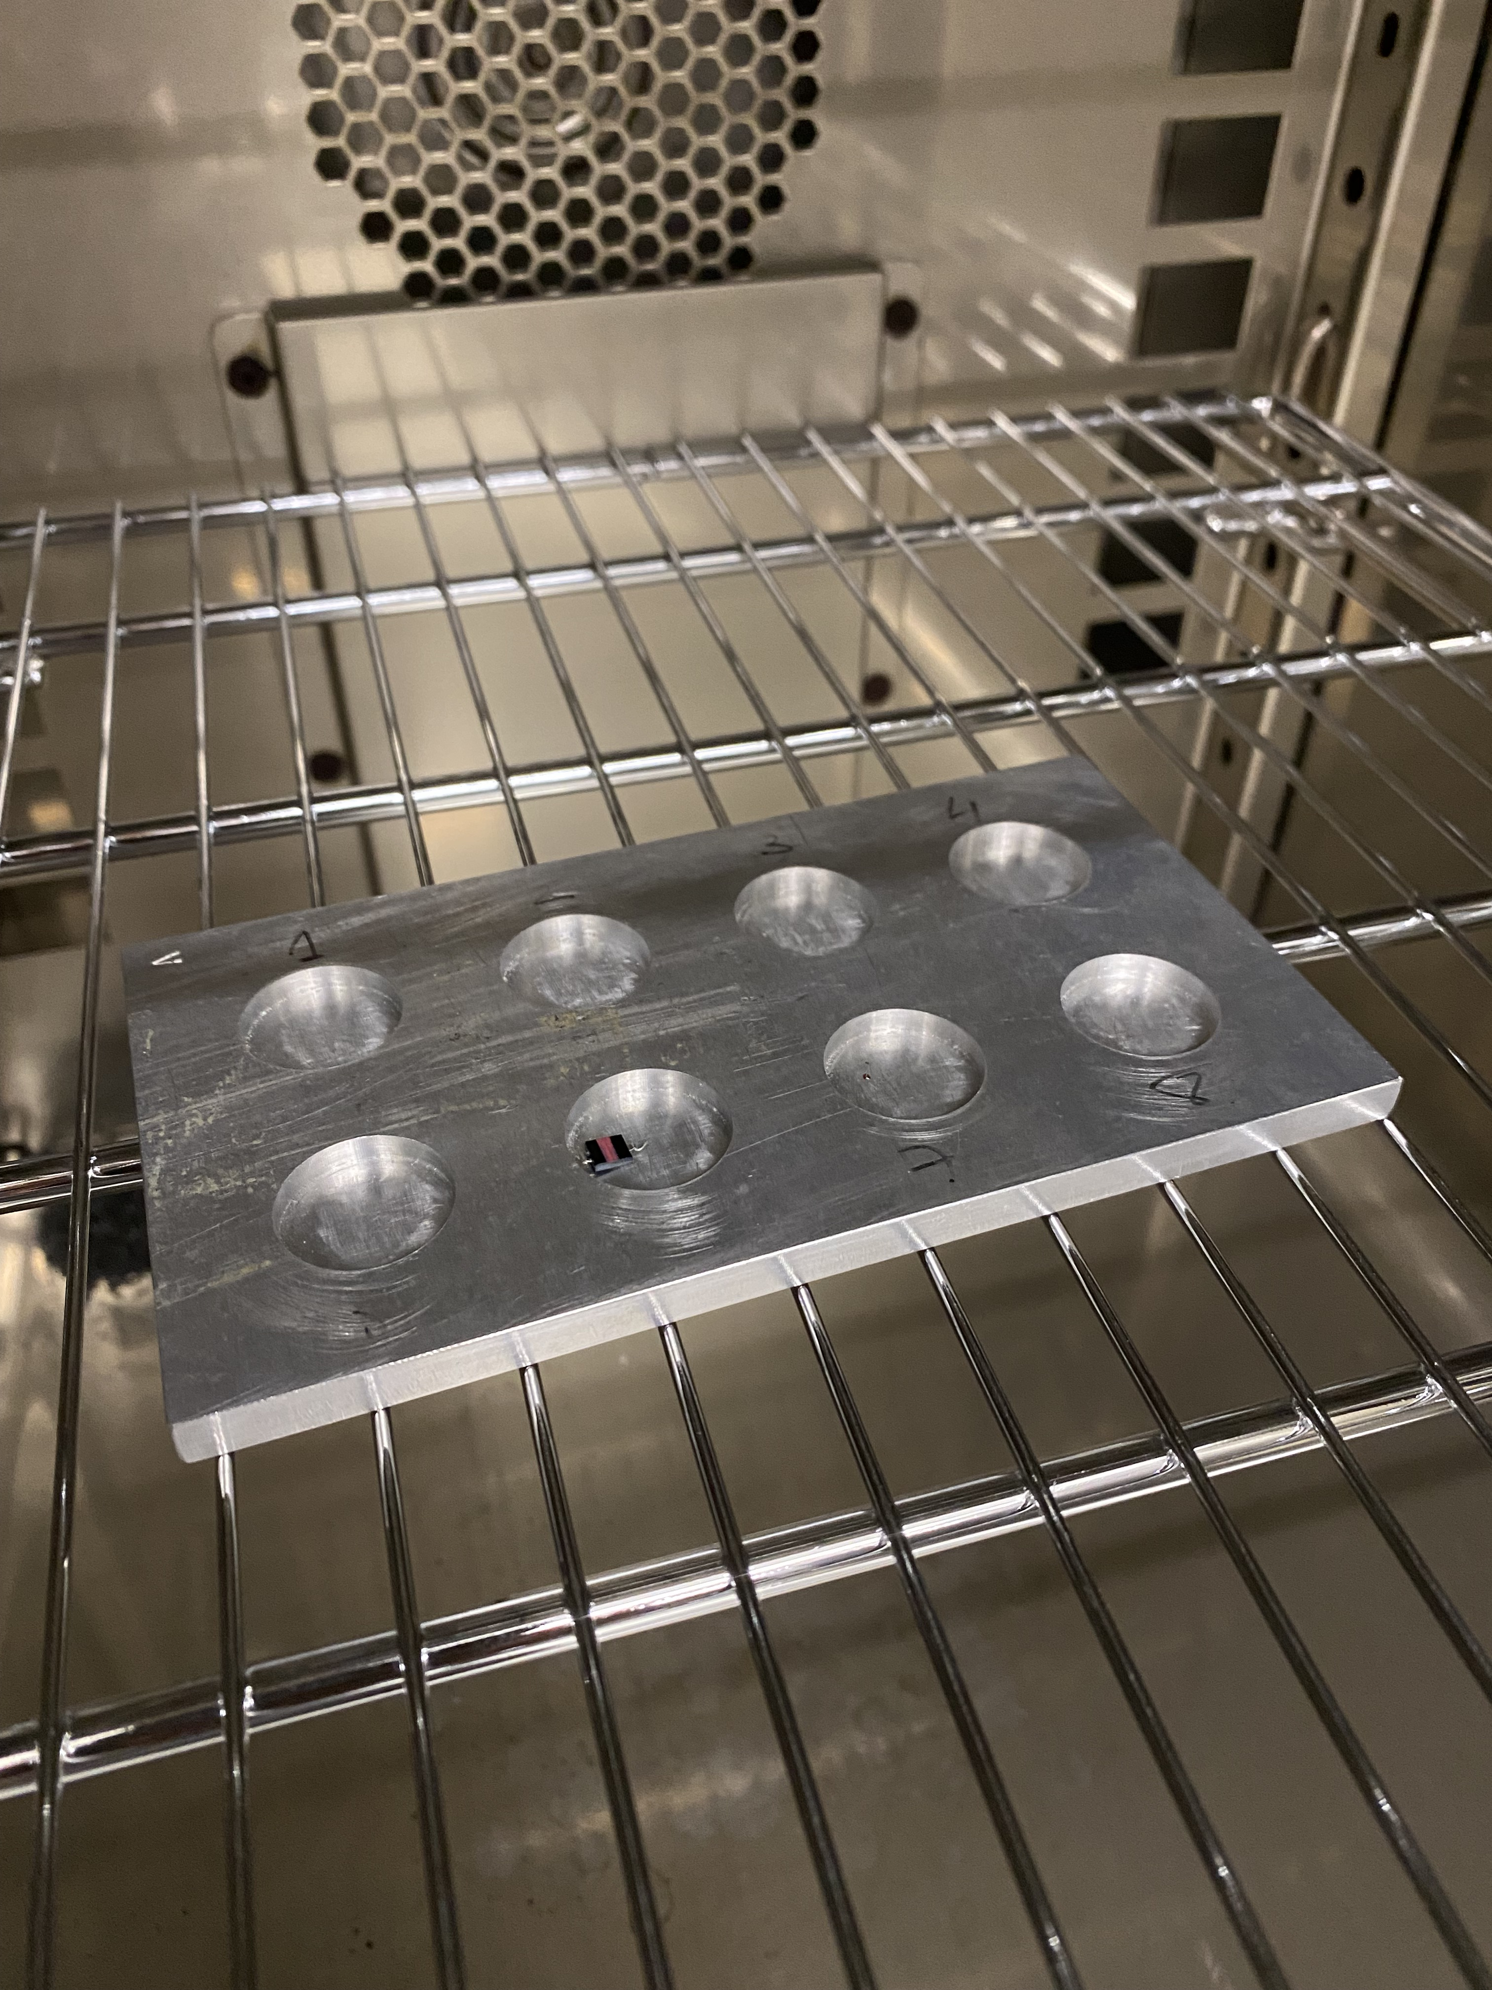
Pin Annealing Study: Setup
Tray heated up in the oven until at equilibrium with the set temperature
Pins placed on the tray, timer starts when the door closes and ends when they’re taken off the tray
They’re then allowed to cool for 5 minutes before being measured at 10 different currents 15 separate times
The average of the forward voltages for the 1mA current is then recorded
Each annealing temperature had several pins from different irradiation runs, though the ones used for studying the relationship between annealing temperatures all came from the same batch (10 minute irradiation run)

Slide 7
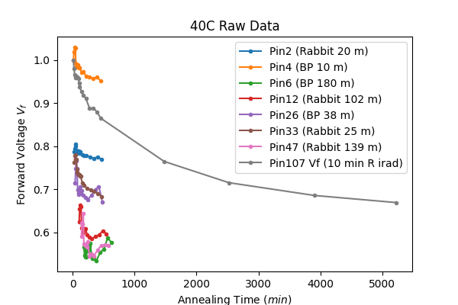
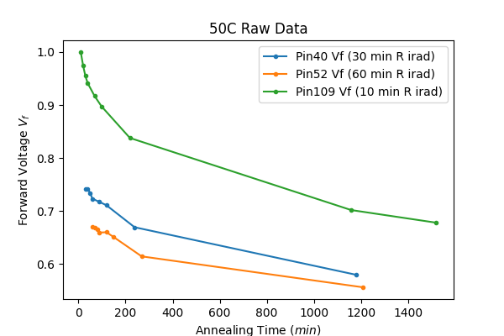
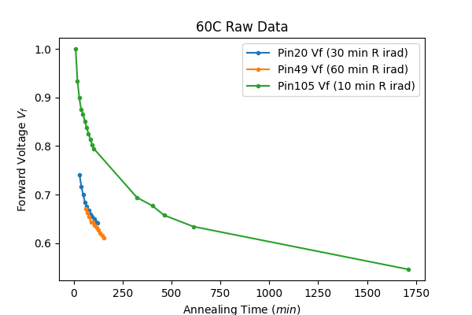
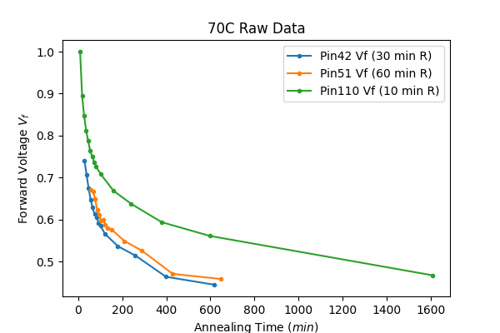
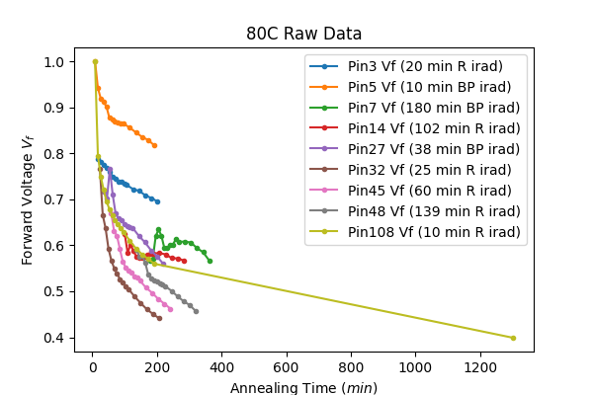
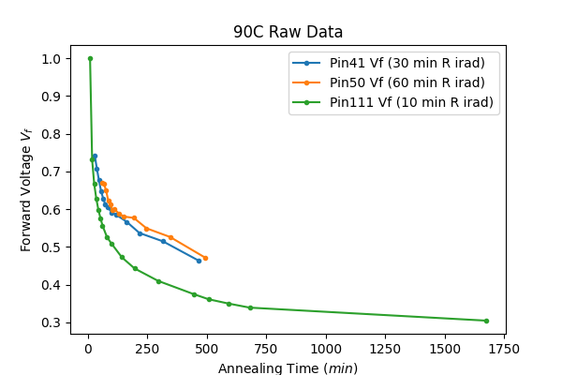
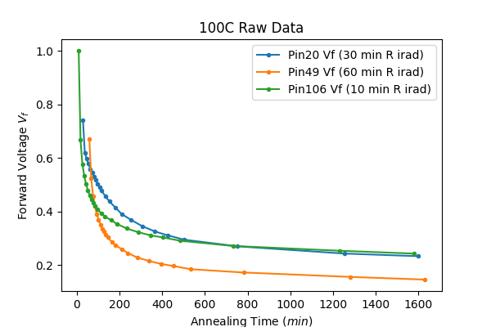
Annealing Graphs with all diodes
We began by annealing different types of pin diodes from both the beam port and rabbit irradiations, but decided to pursue the 10 minute rabbit diodes because we thought the affect of annealing-during-irradiation would be the least
Annealing affects less clear for long irradiation pins (Pin7 80C, Pin6 40C & etc.)
These data were shifted in time to account for heating and cooling during annealing, and a ”place holder” time for the annealing during irradiation
We also tried to account for annealing during irradiation by shifting the starting value assuming the diode was being annealing at ~80C while in the reactor using the shortest irradiated pin

Slide 8
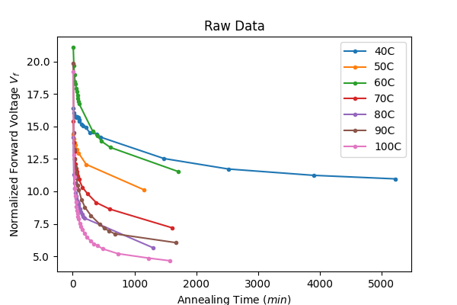
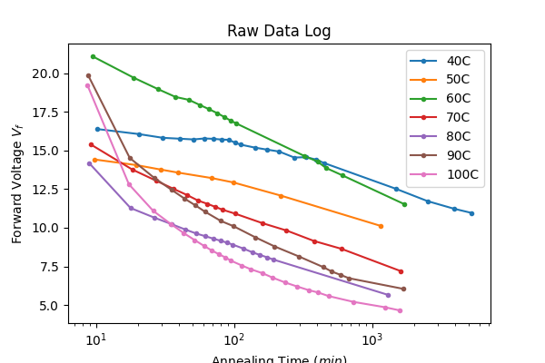
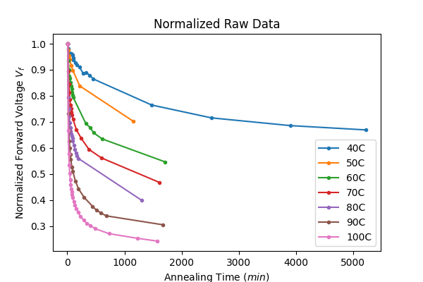
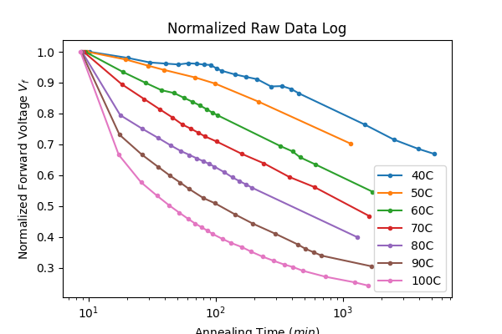
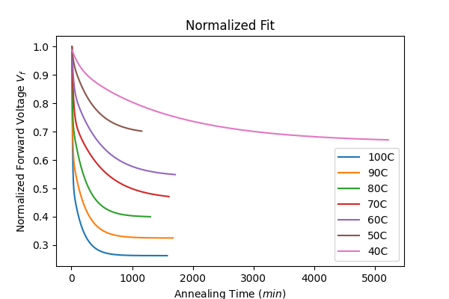
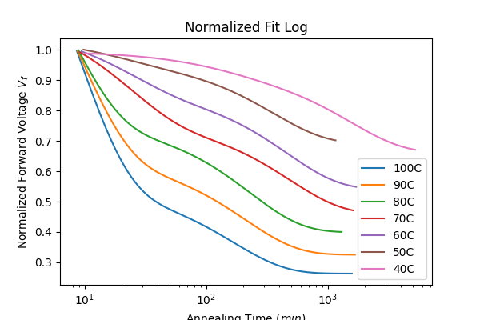
Data: Raw and Normalized
Annealing time data was shifted according to the actual time spent annealing in the oven, accounting for heating up and cooling down
Annealing time also needs to be shifted to account for the 10 minutes spent in the reactor, though we need to know the specific temperature the diodes experienced to do that. OT 4 & 5 should give us more information.
Notice in the “Normalized Fits Log” graph the two bumps per temperature, this corresponds to the two exponents used in the fitting

Slide 9
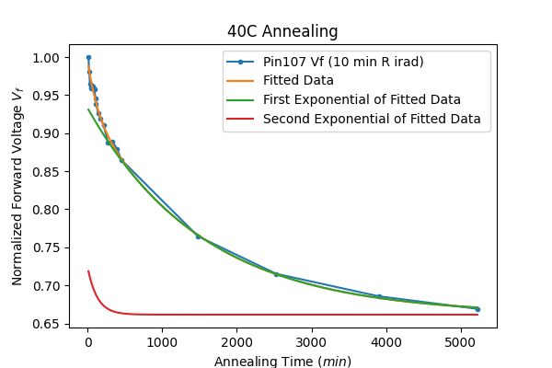
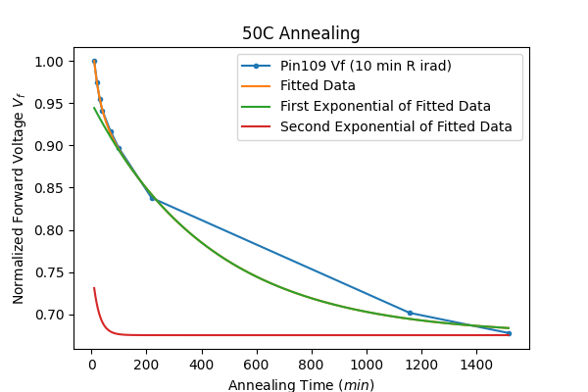
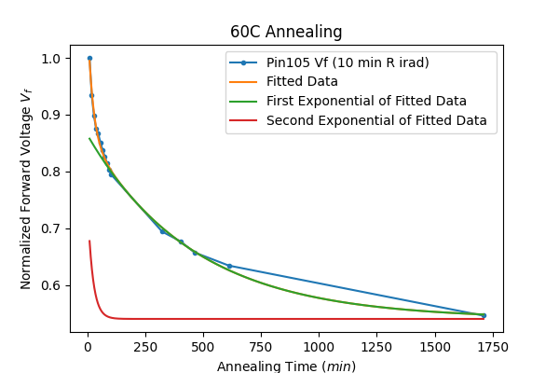
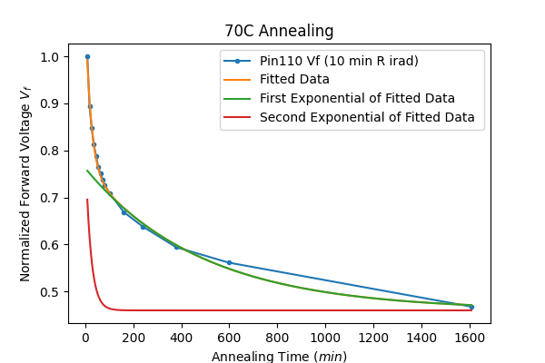
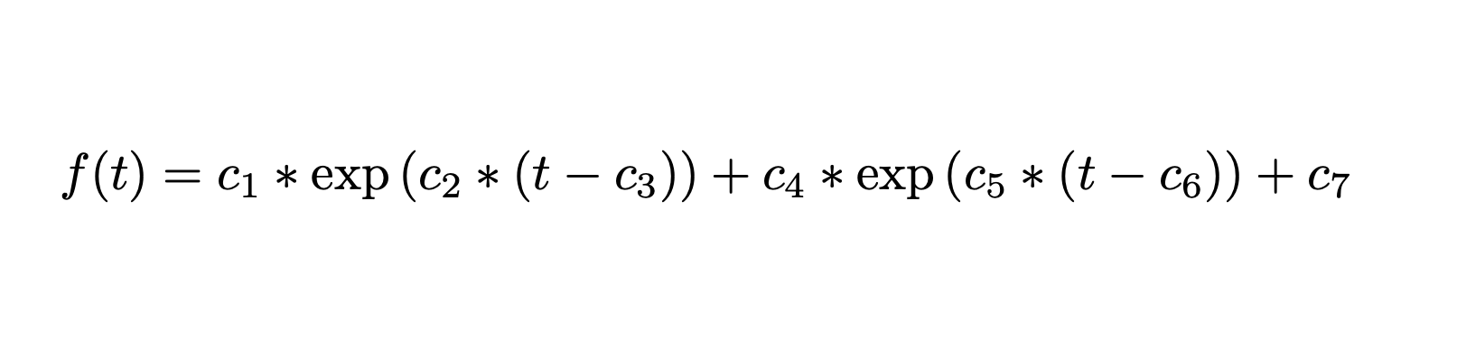
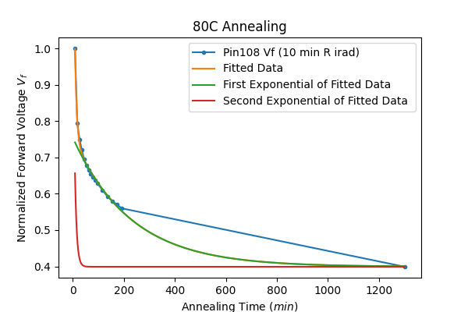
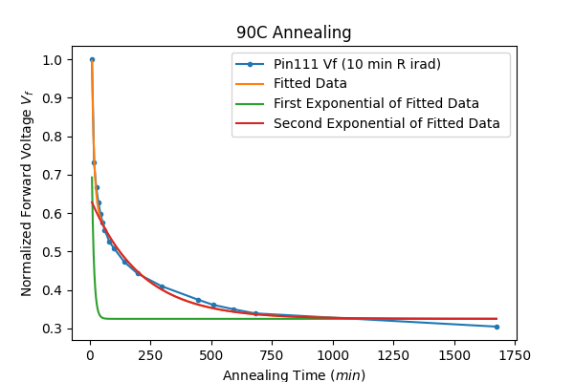
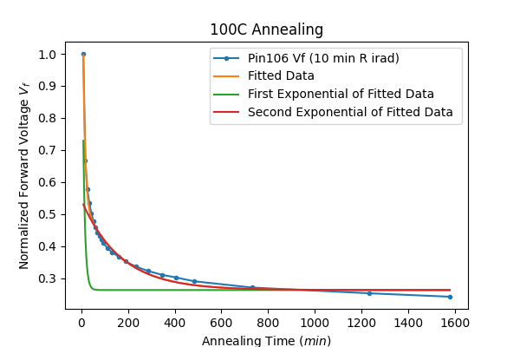
Shifting in Annealing Time and Scaling in Potential / Exponential Fit
The forward voltage has been normalized to the voltage before any annealing
Fitting was to two exponentials and a horizontal shift, to account for the “fast” and “slow” annealing affects, as well as a limiting value for the forward voltage
No indication that annealing affects won’t continue or reverse

Slide 10
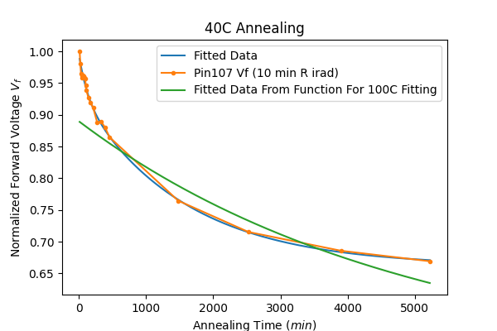
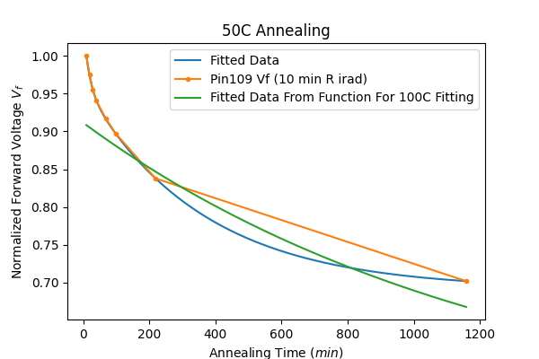
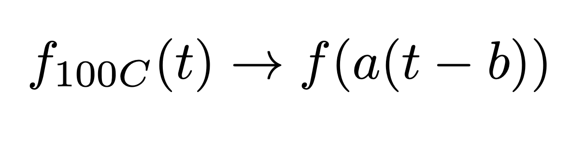
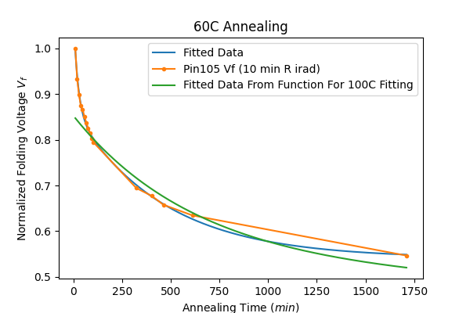
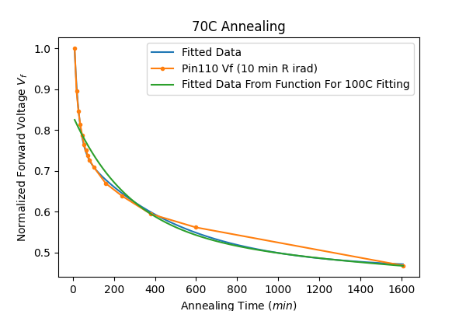
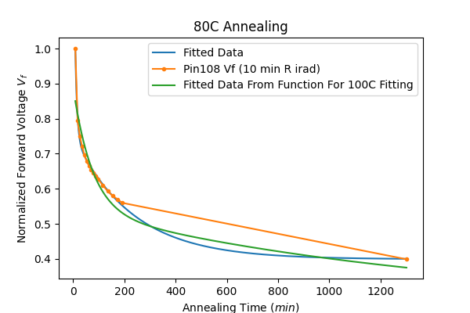
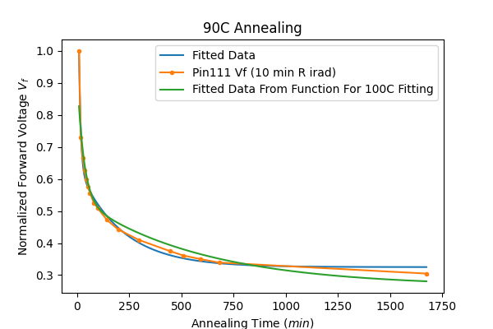
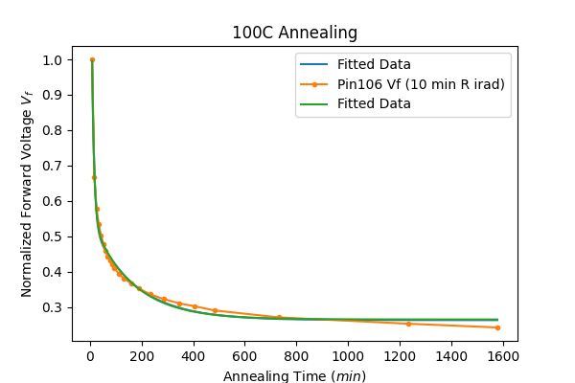
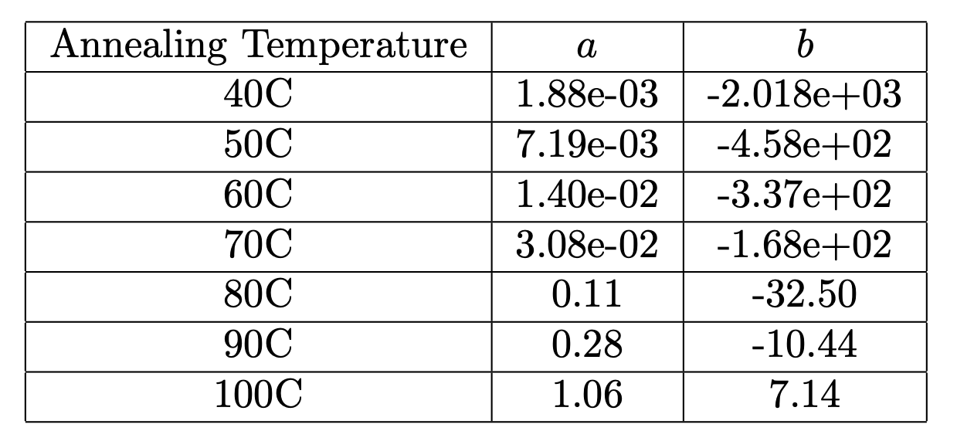
100C Fitting for Other Annealing Temperatures
The 100C annealing data was the most “developed”, and so we were interested in seeing if there was a simple relationship between the fitted curve for 100C and the other temperatures
“a” accounts for the strength of the annealing (assuming a linear response in temperature) while “b” accounts for any pre-annealing that occurred in the reactor
Fits for lower annealing temperatures were not as great as those for higher temperatures due to the difficulties of the significantly greater time needed to develop those curves

Slide 11
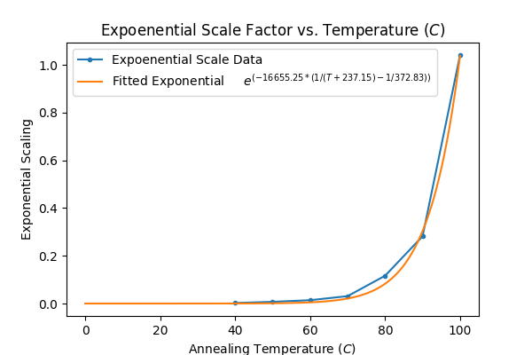
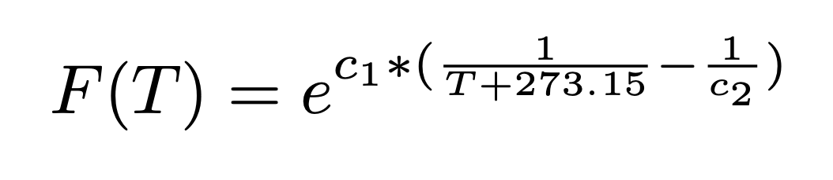
Fitting “Scaling Coefficient” for
Scaling coefficient for each temperature was fitted to the above equation
Found similar relationship between annealing temperature found in the Alibava setup

Slide 12
Conclusion / Remaining questions
Pin annealing results agree with Alibava setup results
Annealing at different temperatures does seem to indicate only a shift and scaling difference, though the shift may only be due to the initial annealing that occurs in the reactor
All data, code and other documents are saved to HEP shared google drive under “Annealing”
Remaining Questions
Analysis of how our diodes are annealed during irradiation may need to be done
Are the diodes annealed at a constant rate?
Temperature during rabbit run should be “pinned” down
Does the temperature hold steady?
Are the temperatures consistent from run to run?
Is there a horizontal asymptote for pin annealing? Is it the same for all annealing temperatures?

